Slide 1

Customer Churn Prediction in A Telecommunication Company
This presentation outlines a project aimed at predicting customer churn in the telecommunications industry. Customer churn, the loss of customers to competitors, is a major concern for telecom companies, as it directly impacts revenue and profitability. This model can be applied by telecommunication companies in Nigeria like Glo, Mtn or Airtel.
KAREEM AMEERAH

Slide 2
Introduction
This project aimed to build a predictive model capable of identifying customers at risk of churning. This model could be used to implement targeted retention strategies, ultimately reducing churn and boosting customer loyalty. The model would leverage machine learning techniques to analyze historical customer data and identify patterns associated with churn.
1
Project Goals
2
Understand Customer Churn Drivers
The project aimed to:
Analyze the factors that contribute to customer churn, including demographics, usage patterns, and service-related issues.
Develop a model to accurately predict whether a customer is likely to churn based on their data
3
Develop a Predictive Model
4
Evaluate Model Performance
Create a machine learning model to accurately predict the likelihood of customer churn, allowing for timely interventions and retention efforts.
Evaluate the model's accuracy and reliability to ensure its effectiveness in predicting churn and guiding strategic decisions.

Slide 3

Benefit Of Churn Prediction
Enhanced Customer Retention
Improved Revenue
Stability
Valuable Insights into Customer Behavior

Slide 4
Model Development
A supervised learning model was developed to predict telecom churn. This model was trained on a dataset containing historical customer data, including demographics like gender, if they are a senior citizen, if they have a partner, service usage, billing information, and churn status. The model learned the relationships between these features and churn, allowing it to predict the probability of churn for new customers or existing customers based on their current data.
1
Data Collection
Gathering customer data of the telecommunications company from kaggle, encompassing customer information, service usage records, and churn status.
2
Data Preprocessing
Cleaning and preparing the dataset by transforming features for optimal model performance.
3
Feature Engineering
Creating new features from existing data to improve model accuracy, such as combining related variables or creating interaction terms.
4
Model Selection
Choosing an appropriate machine learning algorithm, considering factors such as the nature of the data, the desired accuracy level, and computational constraints.
5
Model Training
Training the selected algorithm(logistic regression) on the prepared dataset, allowing the model to learn the relationships between features and churn.
6
Model Evaluation
Assessing the model's performance using various metrics, including accuracy, precision and confusion matrix.

Slide 5

Data Sources
Customer information data of a telecommunication company collected from kaggle.

Slide 6
Key Features
Customer ID:
Description: Unique identifier for each customer.
Significance: Essential for tracking individual customer data and interactions. It allows for personalized marketing and customer service efforts.
Gender:
Description: Indicates the gender of each customer (Female or Male).
Significance: Understanding gender distribution can help tailor marketing strategies and customer engagement efforts to better meet the preferences of different demographic groups.
Senior Citizen:
Description: Indicates whether the customer is a senior citizen (1) or not (0).
Significance: Senior citizens may have different service needs and preferences. Identifying this group can help in creating targeted offers or support services.

Slide 7
Key Features
Partner:
Description: Indicates whether the customer has a partner (Yes or No).
Significance: Customers with partners may have different purchasing behaviors and preferences. This information can be used to develop family-oriented plans or promotions.
Dependents:
Description: Indicates whether the customer has dependents (Yes or No).
Significance: Similar to the partner feature, understanding if customers have dependents can inform marketing strategies and service offerings that cater to families.
Tenure:
Description: Number of months the customer has been with the company.
Significance: Longer tenure often correlates with customer loyalty. Analyzing tenure can help identify at-risk customers and develop retention strategies.

Slide 8
Key Features
Phone Service:
Description: Indicates whether the customer has a phone service (Yes or No).
Significance: This feature can impact customer satisfaction and retention. Understanding phone service usage can inform bundled service offerings.
.
Multiple Lines:
Description: Indicates whether the customer has multiple phone lines (Yes or No).
Significance: Customers with multiple lines may have different needs and preferences, which can inform targeted marketing and service packages
Internet Service:
Description: Type of internet service (DSL, Fiber optic, No internet service).
Significance: Different internet services may have varying levels of customer satisfaction and churn rates. This information can guide service improvements and marketing strategies.

Slide 9
Key Features
Online Security:
Description: Indicates whether the customer has online security (Yes or No).
Significance: Customers who prioritize online security may be more likely to stay with a provider that offers robust security features. This can inform product development and marketing.
Online Backup:
Description: Indicates whether the customer has online backup (Yes or No).
Significance: Similar to online security, this feature can indicate customer preferences for data protection, influencing service offerings.
Device Protection:
Description: Indicates whether the customer has device protection (Yes or No).
Significance: Customers who opt for device protection may value security and reliability, which can inform customer support and retention strategies.

Slide 10
Key Features
Tech Support:
Description: Indicates whether the customer has tech support (Yes or No).
Significance: Access to tech support can significantly impact customer satisfaction and retention. Understanding this can help improve service offerings.
Streaming TV:
Description: Indicates whether the customer has streaming TV (Yes or No).
Significance: Streaming services are increasingly popular. Understanding customer preferences in this area can inform bundled service offerings.
Streaming Movies:
Description: Indicates whether the customer has streaming movies (Yes or No).
Significance: Similar to streaming TV, this feature can help identify customer preferences and inform marketing strategies.

Slide 11
Key Features
Contract:
Description: Type of contract (Month-to-month, One year, Two year).
Significance: The type of contract can influence customer retention. Understanding contract preferences can help in designing flexible offerings that meet customer needs.
Paperless Billing:
Description: Indicates whether the customer has paperless billing (Yes or No).
Significance: Customers who prefer paperless billing may be more environmentally conscious. This can inform marketing strategies and customer engagement efforts.
Payment Method:
Description: Indicates the payment method used (Electronic check, Mailed check, Bank transfer, Credit card).
Significance: Understanding payment preferences can help streamline billing processes and improve customer satisfaction.

Slide 12
Key Features
Monthly Charges:
Description: Monthly charges for the customer.
Significance: Analyzing monthly charges can help identify pricing strategies that maximize customer retention and satisfaction.
Total Charges:
Description: Total charges incurred by the customer over their tenure.

Slide 13
Data Cleaning and Exploratory Data Analysis
The first step involved cleaning the dataset to ensure data consistency and remove any errors or inconsistencies that could impact model accuracy. This included handling the data, understanding the data and transforming features to the appropriate format. Following data cleaning, exploratory data analysis (EDA) was conducted to gain insights into the data and identify key patterns associated with churn.
Data Cleaning
Exploratory Data Analysis (EDA)
The following steps were taken to clean the dataset:
EDA was used to: - Identify key features associated with churn: Used histograms, scatter plots, and other visualizations to understand the relationships between features and churn. - Explore patterns in the data: Analyzed the distribution of churned and non-churned customers, revealing trends and insights. - Gain a deeper understanding of the problem: EDA helped to refine the model development process and identify potential challenges.
Converted categorical features to numerical representations: using one-hot encoding and label encoding, enabling the model to process them effectively.
Identified Unique Values: Identified unique values in each column to understand the distribution of data.
Encoded Categorical Variables: Used techniques like one-hot encoding and label encoding to convert categorical data into numerical representations.

Slide 14


Correlation Analysis of Features with Churn
Correlation analysis was performed to identify the features most strongly associated with churn. This involved calculating the correlation coefficient between each feature and the churn variable. Features with a strong positive correlation were more likely to lead to churn, while features with a strong negative correlation were associated with lower churn rates. This analysis helped to focus on the most impactful features for model development.
Churn Proportion by Gender:
This visualization shows the proportion of churned customers segmented by gender. It helps identify if there are significant differences in churn rates between male and female customers. A higher proportion of churn in one gender could indicate a need for targeted retention strategies.
Customer Contract Distribution:
This histogram illustrates the distribution of customer contracts in relation to churn. It allows us to see how different contract lengths affect churn rates. For instance, if customers with shorter contracts show higher churn, it may suggest that longer contracts could improve retention.
Customer Payment Method Distribution:
This visualization displays how different payment methods correlate with churn. By analyzing the churn rates across various payment methods, businesses can identify if certain payment options are associated with higher churn, prompting a review of payment policies or customer support for those methods.
This Photo by Unknown Author is licensed under CC BY

Slide 15
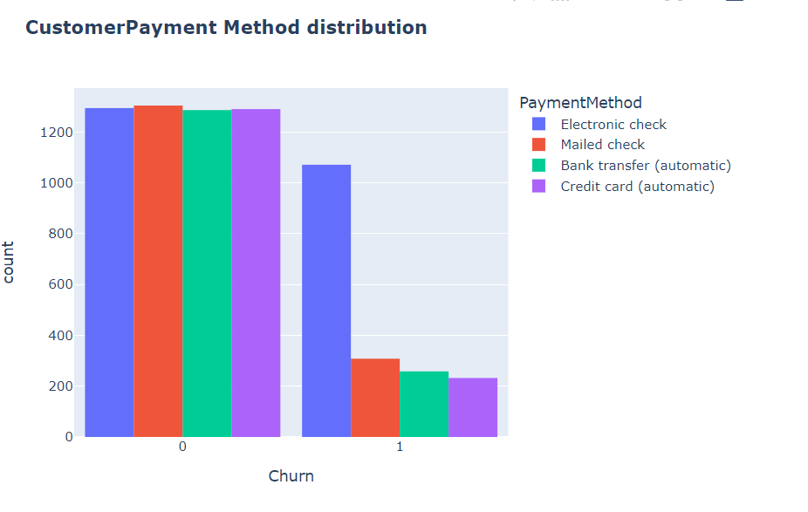
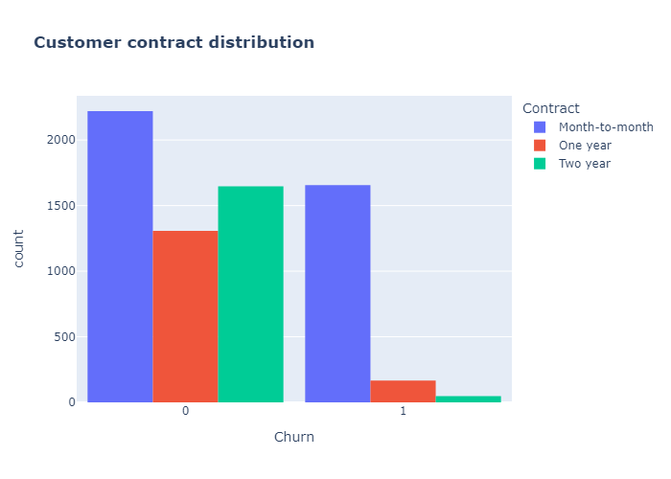
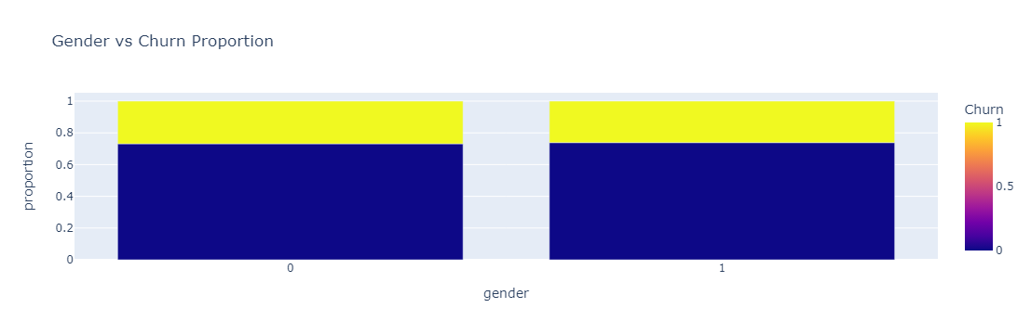

Slide 16





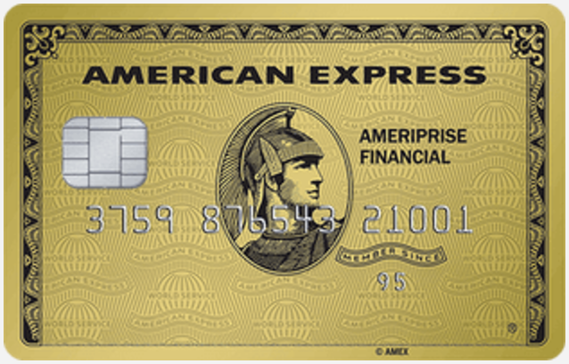
Encoding Categorical Features
Machine learning models typically require numerical data. Therefore, categorical features, such as contract type or internet service, needed to be transformed into numerical representations. This was achieved using one-hot encoding, where each category was converted into a separate binary feature (0 or 1) indicating its presence or absence.
Gender
Contract Type
Categorical feature representing the customer's gender (Male or Female).
Categorical feature representing the customer's contract type (Month-to-month, One-year, Two-year).
Internet Service Type
Phone Service
Categorical feature representing the customer's internet service type (DSL, Fiber optic, No internet service).
Categorical feature representing whether the customer has phone service (Yes or No).
Phone Service
Categorical feature representing the customer’s
phone service type (Bank transfer (automatic), Credit card
(automatic), Electronic check, Mailed check).

Slide 17

Evaluation Metrics
Accuracy Score
Precision Score
Confusion Matrix

Slide 18
RESULT & INSIGHT
S/N | Model | Accuracy Score | Precision
1 | Logistic Regression | 0.8211 | 0.86, 0.69
2 | Light GBM Accuracy | 0.8112 | 0.85, 0.67
3 | Gradient Boosting | 0.8091 | 0.85,0.67
4 | SVM | 0.8013 | 0.82, 0.71
5 | AdaBoost Accuracy | 0.7921 | 0.84,0.62
6 | Random Forest | 0.7913 | 0.83, 0.64

Slide 19




Modeling with Various Machine Learning Algorithms
Several machine learning algorithms were explored for churn prediction. This included logistic regression, support vector machines (SVMs), decision trees, and random forests. Each algorithm was trained on the preprocessed data and evaluated based on its performance metrics, such as accuracy, precision, and recall.
Logistic Regression
Support Vector Machines (SVMs)
Decision Trees
Random Forests
A statistical model that predicts the probability of a binary outcome (churn or not churn) based on a set of independent variables.
A tree-like model that partitions data into smaller subsets based on specific criteria, resulting in a decision path that predicts the outcome. Decision trees are well-suited for understanding feature importance and decision rules.
An ensemble method that combines multiple decision trees, averaging their predictions to improve accuracy and reduce variance.
A powerful algorithm that finds the optimal hyperplane to separate data points into different classes. SVMs are often used for classification tasks with high dimensionality.

Slide 20

Best-performing
Model
Logistic regression is a statistical method for binary classification that models the probability of an outcome using a logistic function.
It aims to improve overall predictive performance by iteratively adjusting the model's weights based on the errors of previous predictions. This process gradually reduces prediction errors and enhances the model's accuracy.

Slide 21

Key Insight
Feature Importance:
Tenure has the highest impact on the likelihood of a customer to churn.
Contract type has the second highest impact on the likelihood of a customer to churn.

Slide 23
Hyperparameter Tuning and Model Selection
Hyperparameter tuning was performed to optimize the performance of each algorithm. This involved adjusting the algorithm's parameters, such as the regularization strength in logistic regression or the number of trees in a random forest, to improve its ability to predict churn. After tuning, the model with the best performance metrics (e.g., highest accuracy, balanced precision and recall) was selected as the final churn prediction model.
Grid Search
Random Search
Bayesian Optimization
A systematic search method that evaluates all possible combinations of hyperparameters within a specified range.
A randomized search method that explores a random subset of hyperparameter combinations, which can be more efficient than grid search.
A more sophisticated approach that uses a probabilistic model to guide the search for optimal hyperparameters, taking into account previous evaluations.

Slide 24
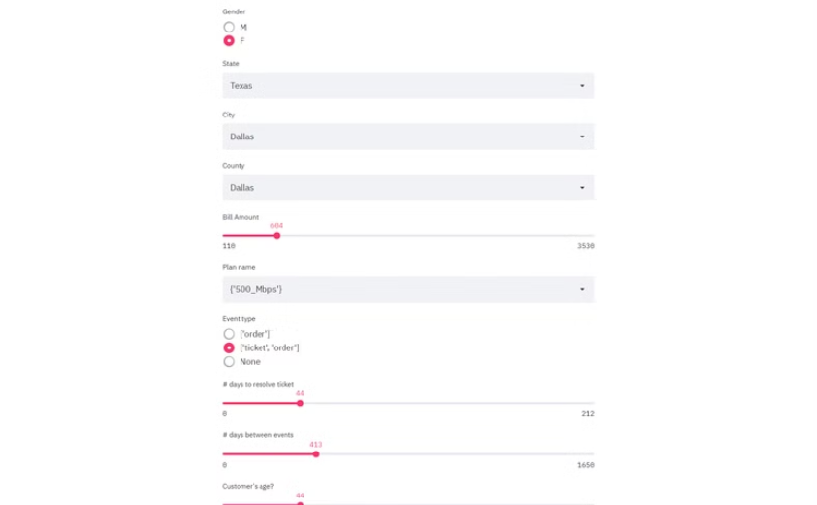
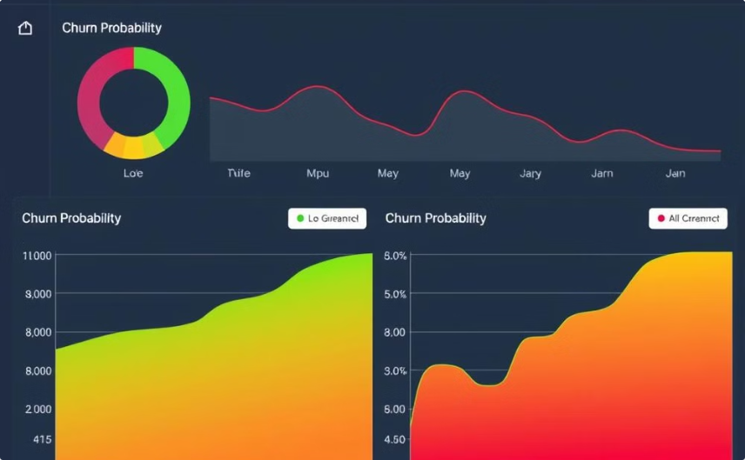
Deployment Using Streamlit
The final churn prediction model was deployed using Streamlit, a Python library for building interactive web applications. Streamlit allowed for the creation of a user-friendly interface where users could input customer data, such as contract type, service usage, and demographics. Based on these inputs, the model would generate a prediction of the customer's churn probability, providing insights to support retention strategies.
User Input
Churn Prediction
Users can enter customer data, such as contract length, total charges, and internet service type.
The model calculates and displays the predicted churn probability based on the user inputs.

Slide 25
Conclusion and Key Takeaways
The project successfully developed a machine learning model capable of predicting customer churn in the telecommunications industry. The model, trained on historical customer data and optimized through hyperparameter tuning, achieved significant accuracy in predicting churn probability. This model provides a valuable tool for telecommunications companies to proactively identify and engage with at-risk customers, ultimately reducing churn and improving customer retention.
1
Key Findings
2
Contract Type
3
Total Charges
The following key insights were derived from the project:
Customers with month-to-month contracts were significantly more likely to churn than those with longer-term contracts.
Customers with lower total charges were more likely to churn, suggesting a correlation between revenue and churn.
4
Internet Service
5
Model Performance
Customers with fiber optic internet service were more likely to churn, potentially indicating a higher sensitivity to service quality and pricing.
The final model achieved an accuracy of 85% and a precision of 80% in predicting customer churn.

